Slide 1

Project 3 – Data Cleaning Group 7 - Marketing
Michel Brun
January 3rd 2022
Notes:
Michel

Slide 3
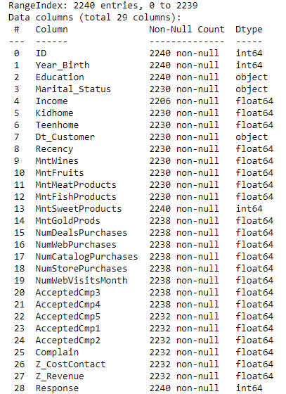
Description of Dataset
Notes:
Abdel

Slide 4
Challenges
Data Cleaning (identifying duplicates, outliers, NaN)
Removing lines based on index (impacting all the others indexes)
Connecting Python to MySQL
Finding accurate SQL queries
Notes:
Michel

Slide 5
Process
On Python using Pandas :
File description with .info
Looking for numeric and non-numeric data
Check for duplicates and removing if any
Check missing data
Deleting rows with at least 10 NaN values out of 29
Plot Outliers
Replace 'Year_Birth' < 1920, 'Income'] > 500000, 'Recency' > 1000, 'MntWines' > 1500,… by NaN
Clean Marital Status : Alone by Single, Absurd by Single, YOLO by Married (and identifying a duplicates)
Check Data Range of Date_Customer is correct
Notes:
Abdel

Slide 6
Process
On Python using Pandas :
Replace Year_Birth with mode, Income, Recency, MntWines,… by mean (since now mean is not impacted by outliers anymore)
Check plot outliers after cleaning
Delete Reset_index columns created
Encoding Education and Marital Status
Exporting CSV files
Link to MySQL creating database project3 and table Marketing
MySQL
Queries
Github
PPT
Notes:
Abdel

Slide 7
Learnings and improvements
reset_index(inplace=True) function
Finding duplicates with different ID not using duplicate function
Connecting MySQL to Python
Using Range on MySQL
Notes:
Abdel

Slide 8
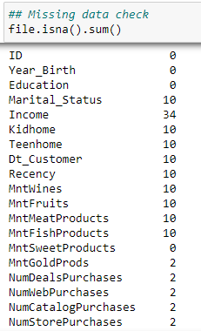
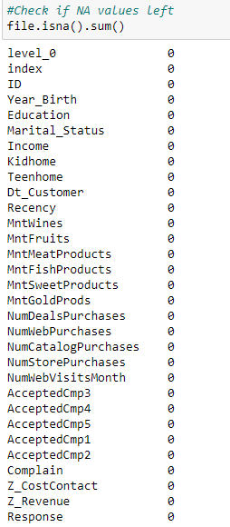
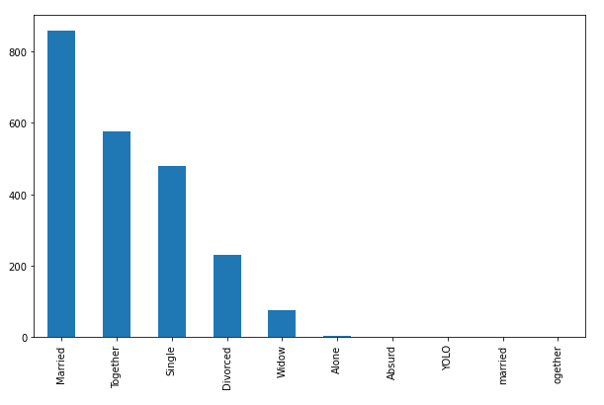
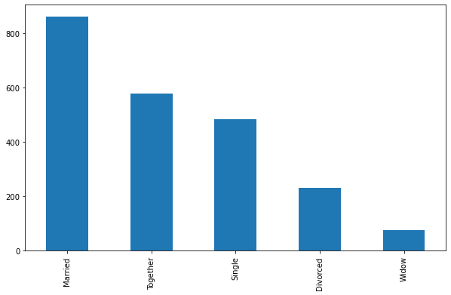
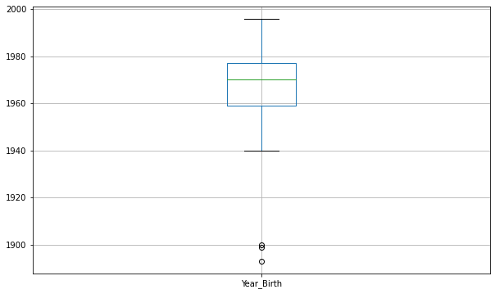
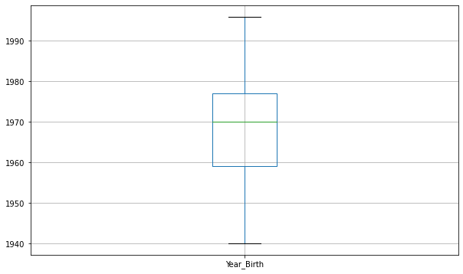
Comparison of the initial and final datasets
Notes:
Michel

Slide 9
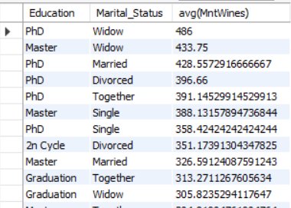
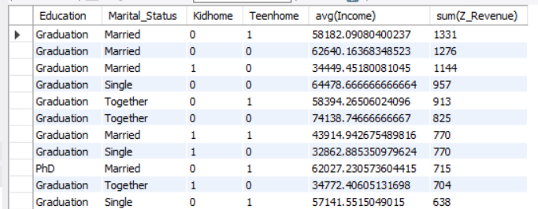
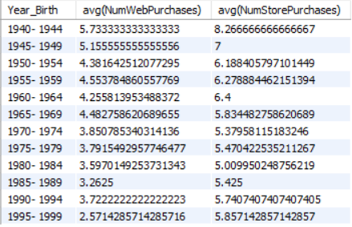
MySQL analysis
Widowed and people with PhD are the one who buys the most of Wines
People with Graduation degree generates the most revenue no maters their Marital Status, # of Kids or Teens and Income
Older Generations are the one buying the most online & offline but younger generations buy 3times more in store than online
Notes:
Abdel

Slide 10
Thank you

